Slide 1
FREE SOFTWARE
GROUP-10

Slide 2
Farhan Siddiqui | 87

Slide 3
What is Free Software ?
Free software allow users to run the software for any purpose as well as to study .
It is a matter of liberty, not price: all users are legally free to do what they want with their copies of a free software.
It allow users to openly shared the source code so that people are encouraged to voluntarily improve the design of the software.
Free Software allow users to change, and distribute it and any adapted versions.

Slide 4




The Four Freedoms
Use
Study
Share
Improve

Slide 5
Licenses
Free Software license are Public domain, permissive license, LGPL and Copyleft
Free software license grants the extensive rights of a software to modify .
Free-software licenses are applied to software in source code
Free Software license grants the right to redistribute the software.

Slide 6
Right to perform
Right to display
License Rights
Right to modify
Right to copy

Slide 7




Advantages
Autonomy
No Lock-in
Share & Copy
Competition

Slide 8




Advantages
Collaboration
Security
Reuse Code
Innovation

Slide 9
Disadvantages of Free Software
Reduced incentive for programmers
- the right sort of software won't get written without such incentives
Reduced reward for writing good programs
Reduced investing in programming
Removes the beneﬁts of ﬁnancially-fuelled competition from the software market

Slide 10
Open Source
Open source is a development methodology
Open source has a distribution of licence
Open source just has the availability of source code
Open source can be distributed freely
Open source have an integrity of authors source code
Free software
Free software is a social movement
Freedom to run program for any purpose
Free software gives freedom to study about there code
It allows user to distribute the copies
Freedom to modify the program and distribute in public

Slide 11
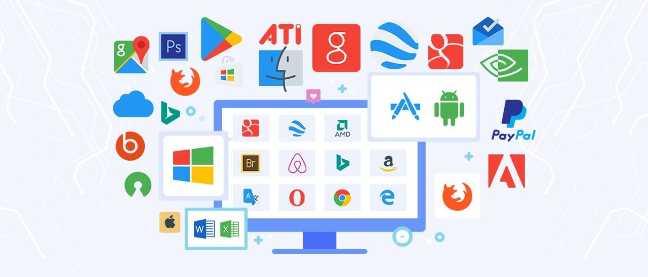
THANK YOU
GROUP-10

